Slide 1
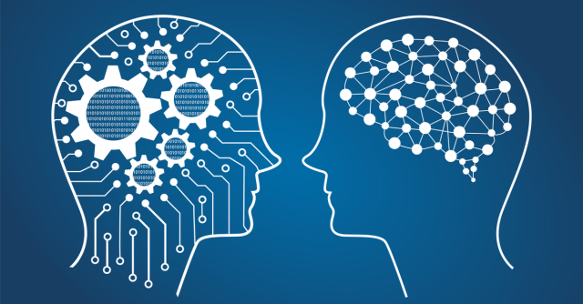
Deep Neural Networks
Introduction into Information Retrieval

Slide 2

Neural networks
Algorithms, modeled loosely after the human brain, that are designed to recognize patterns.
The patterns they recognize are numerical, contained in vectors (real-world data: images, sound, text, time-series, etc.)
NNs help us cluster and classify.
NNs can extract features that are fed to other algorithms for clustering and classification.
Deep NNs are components of larger machine-learning applications involving algorithms for reinforcement learning, classification and regression.

Slide 3
What kind of problems does deep learning solve? Classification.
Classification examples:
spam or not_spam in an email filter,
good_guy or bad_guy in fraud detection,
angry_customer or happy_customer in customer relationship management.
We need to find labeled data
or create one (with a service like AWS Mechanical Turk or others)

Slide 4
What kind of problems does deep learning solve? Clustering.
Clustering (unsupervised learning) examples:
Search: Comparing documents, images or sounds to surface similar items.
Anomaly detection: The flipside of detecting similarities is detecting unusual behavior (for example, fraud).
No need to find labeled data!

Slide 5

What kind of problems does deep learning solve? Predictive Analytics: Regressions.
DL can establish correlations between present events and future events.
It can run regression between the past and the future.

Slide 6
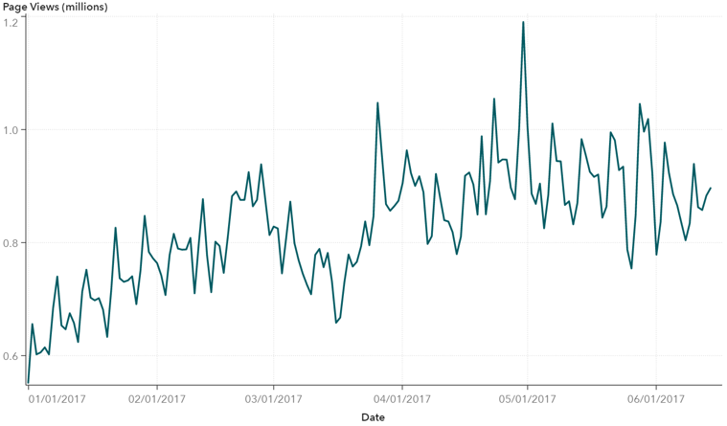
What kind of problems does deep learning solve? Predictive Analytics: Regressions.
Given a time series, deep learning may read a string of numbers and predict the number most likely to occur next. Examples:
Hardware breakdowns
Health breakdowns
Customer churn
Notes:
Hardware breakdowns (data centers, manufacturing, transport)
Health breakdowns (strokes, heart attacks based on vital stats and data from wearables)
Customer churn (predicting the likelihood that a customer will leave, based on web activity and metadata)
Employee turnover (ditto, but for employees)

Slide 7

What kind of problems does deep learning solve? Predictive Analytics: Regressions.
It’s possible to create smarter agents that combine NNs with other algorithms like reinforcement learning.

Slide 8
Neural Network Elements
Deep learning = networks composed of several layers.
The layers are made of nodes.
A node is just a place where computation happens, loosely patterned on a neuron in the human brain.

Slide 9
Node diagram

Slide 10
Neural Network Elements
A node combines input from the data with a set of coefficients, or weights, that assign significance to inputs for the task the algorithm is trying to learn.
These input-weight products are summed, and the sum is passed through a node’s so-called activation function
determines whether and to what extent that signal progresses further through the network to affect the ultimate outcome.
Pairing adjustable weights with input features is how we assign significance to those features regarding how the network classifies and clusters input.

Slide 11
General NN diagram
A node layer is a row of neuronlike switches that turn on or off as the input is fed through the net.
Each layer’s output is simultaneously the subsequent layer’s input, starting from an initial input layer receiving your data.

Slide 12
Key Concepts of Deep Neural Networks
Deep-learning networks are distinguished from the commonplace single-hidden-layer NNs by their depth = the number of hidden layers
Earlier versions of NNs such as the first perceptrons were shallow, composed of 1 input and 1 output layer, and at most 1 hidden layer in between.
More than 3 layers (including input and output) qualifies as “deep” learning.
So deep means more than 1 hidden layer.

Slide 13


Slide 14
Feature hierarchy in deep-learning networks
Each layer of nodes trains on a distinct set of features based on the previous layer’s output.
More advance layers can recognize more complex features, since they aggregate and recombine features from the previous layers.
This is known as feature hierarchy, and it is a hierarchy of increasing complexity and abstraction.
Deep-learning networks capable of handling very large, high-dimensional data sets with billions of parameters that pass through nonlinear functions.

Slide 16
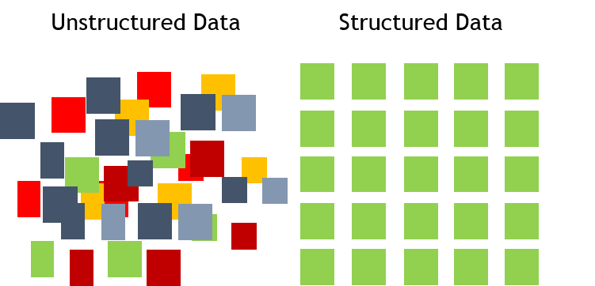
The problems deep learning solves best
Can discover latent structures within unlabeled, unstructured data, which is most data in the world.
Unstructured data = raw media; i.e. pictures, texts, video and audio recordings.

Slide 17


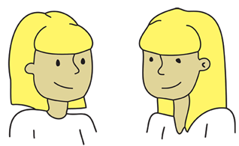
The problems deep learning solves best
The processing and clustering the world’s raw, unlabeled media, discerning similarities and anomalies in data that no human has organized in a relational database or ever put a name to.
Example: DL can cluster a million images according to their similarities: cats in one corner, ice breakers in another, and in a third all the photos of your grandmother.
Can learn from huge quantities of unlabeled data – a huge advantage over other algorithms!

Slide 18


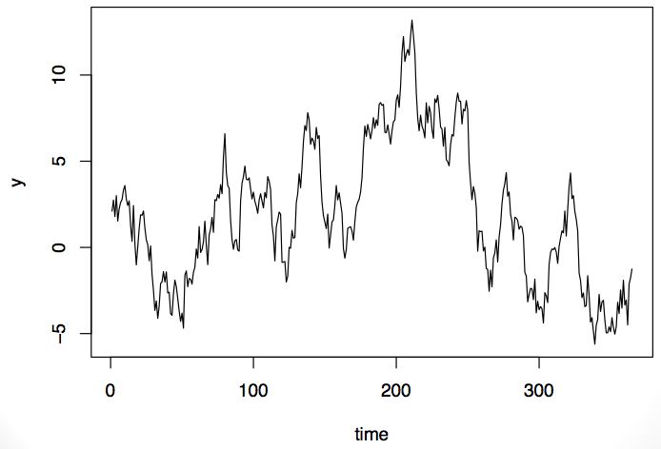
Other domains…
Deep learning might cluster raw text such as emails or news articles.
Emails full of angry complaints <-> satisfied customers <-> spambot messages
With time series, data might cluster around normal behavior and anomalous behavior.
Activity of normal user and troll in Twitter;
Maybe voice messages, sensor data, social media, etc.

Slide 19

Finally… no feature engineering ☺
Deep-learning networks perform automatic feature extraction without human intervention, unlike most traditional machine-learning algorithms.
Feature extraction is a task that can take teams of data scientists years to accomplish.

Slide 20
Automated feature engineering with DL
When training on unlabeled data, each node layer in a deep network learns features automatically by repeatedly trying to reconstruct the input
attempts to minimize the difference between the network’s guesses and the probability distribution of the input data itself – feature extraction;
learn to recognize correlations between certain relevant features and optimal results – feature selection.
connections between feature signals and what those features represent with full reconstruction, or
with labeled data
Notes:
Restricted Boltzmann machines, for examples, create so called reconstructions in this manner.

Slide 21

Predictive nature of Deep Learning
Deep-learning networks end in an output layer: a logistic, or softmax, classifier that assigns a likelihood to a particular outcome or label.
We call that predictive, but it is predictive in a broad sense.
Example: given raw data in the form of an image, a deep-learning NN may decide that the input data is 90% likely to represent a person.

Slide 22
Example: Feedforward Networks
Our goal in using a NN is to make decision of least error as fast as possible.
Each step for a NN involves a guess, an error measurement and a slight update in its weights, an incremental adjustment to the coefficients – incremental improvement.

Slide 23

Feedforward Networks, cont.
A model – a collection of weights
it is an attempt to model data’s relationship to ground-truth labels, to grasp the data’s structure.
There are attempts to learn the structure of NN!
Models start out bad and end up less bad, changing over time as the NN updates its parameters.
This is because NN is born in ignorance. It does not know which weights and biases will translate the input best to make the correct guesses.
It must start out with a guess, and then try to make better guesses sequentially as it learns from its mistakes.

Slide 24

Example
Input enters the network. The coefficients, or weights, map that input to a set of guesses the network makes at the end.
input * weight = guess
Weighted input results in a guess about what that input is. The NN then takes its guess and compares it to a ground-truth about the data, effectively asking an expert “Did I get this right?”
Notes:
Here is a simple explanation of what happens during learning with a feedforward neural network, the simplest architecture to explain.

Slide 25

Example, cont.
The difference between the network’s guess and the ground truth is its error.
The network measures that error, and walks the error back over its model, adjusting weights to the extent that they contributed to the error.

Slide 26

Example, cont.
Three key functions of NNs:
scoring input,
calculating loss,
updating the model
A NN is a corrective feedback loop, rewarding weights that support its correct guesses, and punishing weights that lead it to error.

Slide 27
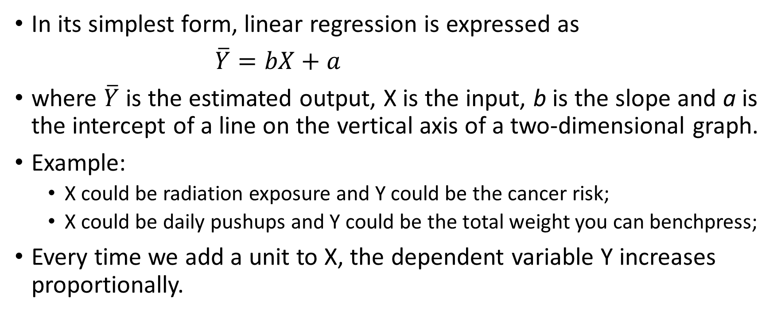
Linear Regression
In its simplest form, linear regression is expressed as
$\overline{Y}=bX+a$
where $\overline{Y}$ is the estimated output, X is the input, b is the slope and a is the intercept of a line on the vertical axis of a two-dimensional graph.
Example:
X could be radiation exposure and Y could be the cancer risk;
X could be daily pushups and Y could be the total weight you can benchpress;
Every time we add a unit to X, the dependent variable Y increases proportionally.

Slide 28
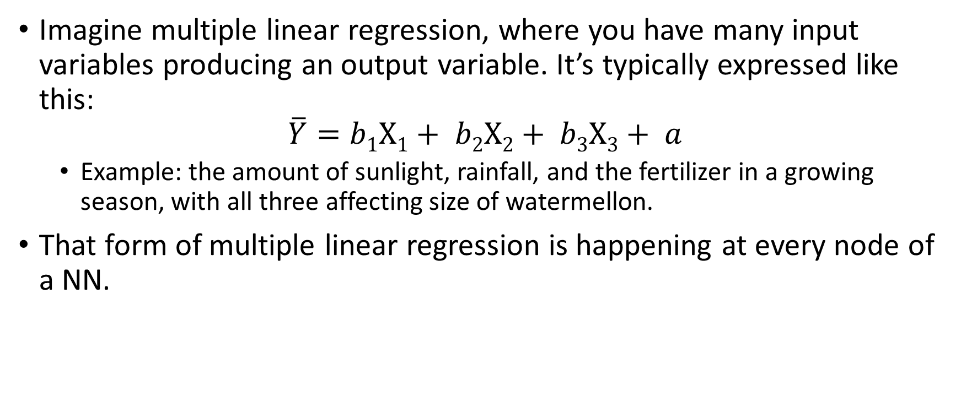
Multiple Linear Regression
Imagine multiple linear regression, where you have many input variables producing an output variable. It’s typically expressed like this:
$$\overline{Y}=b1X1+ b2X2+ b3X3+ a$$
Example: the amount of sunlight, rainfall, and the fertilizer in a growing season, with all three affecting size of watermellon.
That form of multiple linear regression is happening at every node of a NN.

Slide 29
Multiple Linear Regression
For each node of a single layer, input from each node of the previous layer is recombined with input from every other node.
That is, the inputs are mixed in different proportions, according to their coefficients, which are different leading into each node of the subsequent layer.
In this way, a NN tests which combination of input is significant as it tries to reduce error.

Slide 30
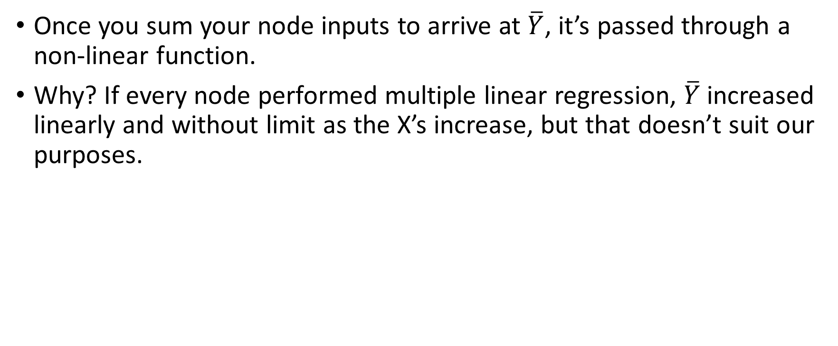
Multiple Linear Regression, cont.
Once you sum your node inputs to arrive at $\overline{Y}$, it’s passed through a non-linear function.
Why? If every node performed multiple linear regression, $\overline{Y}$increased linearly and without limit as the X’s increase, but that doesn’t suit our purposes.

Slide 31
Multiple Linear Regression, cont.
We need to build a switch (like a neuron…) at each node that turns on and off, depending on whether it should let the signal of the input pass through to affect the ultimate decisions of the network.
We have a classification problem: does the input’s signal indicate the node should classify it as enough, or not_enough, on or off?
A binary decision can be expressed by 1 and 0, and
logistic regressions a non-linear function that squashes input to translate it to a space between 0 and 1.

Slide 32

Sigmoid function
The nonlinear transforms at each node are usually s-shaped functions similar to logistic regression. They go by the names of sigmoid, tanh, etc., and they shaping the output of each node.
The output of all nodes, each squashed into an s-shaped space between 0 and 1, is then passed as input to the next layer in a feed forward NN, and so on until the signal reaches the final layer of the NN, where decisions are made.

Slide 33
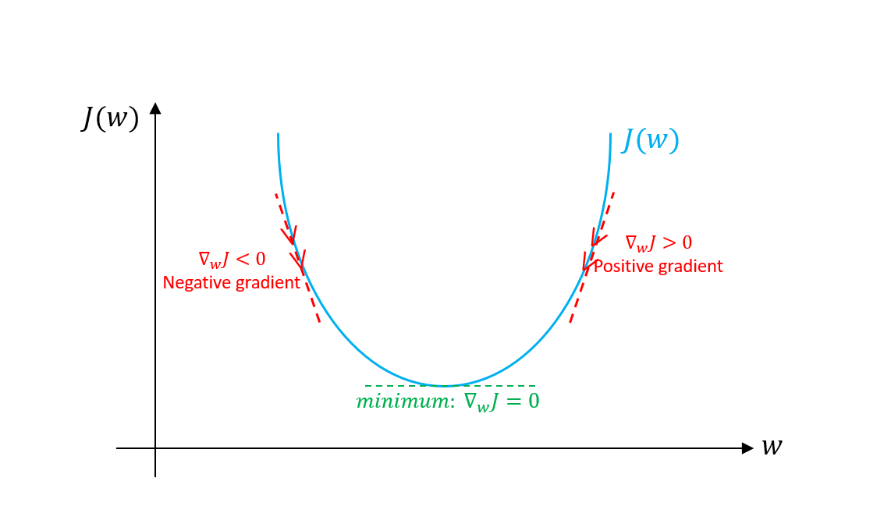
Gradient Descent
The name for one commonly used optimization function that adjusts weights according to the error they caused is called “gradient descent.”
Gradient is another word for slope – in its typical form on an x-y graph representing how two variables relate to each other:
the change in money over the change in time, etc.

Slide 34
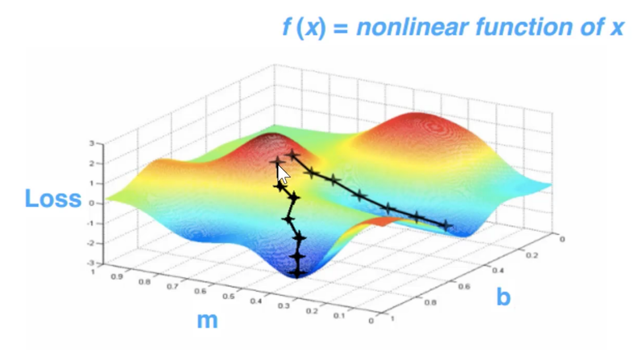
Gradient Descent
The slope describes the relationship between the network’s error and a single weight = how does the error vary as the weight is adjusted.
Which weight will produce the least error? Which one correctly represents the signals contained in the input data, and translates them to a correct classification?

Slide 35
Gradient Descent, cont.
As a neural network learns, it slowly adjusts many weights so that they can map signal -> meaning correctly.
The relationship between network Error E and each of those weights w is a derivative, dE/dw, that measures the degree to which a slight change in a weight causes a slight change in the error.

Slide 36
Gradient Descent, cont.
Each weight is just one factor in a deep network that involves many transforms;
the signal of the weight passes through activations and sums over several layers,
we use the chain rule of calculus to march back through the networks activations and outputs and finally arrive at the weight in question, and its relationship to overall error.

Slide 37
Chain rule
In a feedforward network, the relationship between the net’s error and a single weight will look something like this:
Given two variables, Error and weight, that are mediated by a third variable, activation, you can calculate how a change in weight affects a change in Error by
calculating how a change in activation affects a change in Error, and
how a change in weight affects a change in activation.
The essence of learning in DL is – adjusting a model’s weights in response to the error it produces, until you can’t reduce the error any more.

Slide 38
Optimization Algorithms
Some examples of optimization algorithms include:
ADADELTA
ADAGRAD
ADAM
NESTEROVS
NONE
RMSPROP
SGD
CONJUGATE GRADIENT
HESSIAN FREE
LBFGS
LINE GRADIENT DESCENT

Slide 39

Activation Functions
The activation function determines what output a node will generate base upon its input. Usually, the activation function is set at the layer level and applies to all neurons in that layer. Some examples include:
CUBE
ELU
HARDSIGMOID
HARDTANH
IDENTITY
LEAKYRELU
RATIONALTANH
RELU
SIGMOID
SOFTMAX
SOFTPLUS
SOFTSIGN
TANH
rectified linear unit (ReLU)

Slide 40
Custom layers, activation functions and loss functions
Most DL platforms support custom Layers, Activations and Loss Functions

Slide 41
Logistic Regression
On a deep NN of many layers, the final layer has a particular role.
When dealing with labeled input, the output layer classifies each example, applying the most likely label.
Each node on the output layer represents one label, and that node turns on or off according to the strength of the signal it receives from the previous layer’s input and parameters.
Each output node produces two possible outcomes, the binary output values 0 or 1 – binary classification

Slide 42
Logistic Regression, cont.
While NNs working with labeled data produce binary output, the input they receive is often continuous.
Example:
a recommendation engine must make a binary decision about whether to serve an ad or not.
the input it bases its decision on could include how much a customer has spent on Amazon in the last week, or how often that customer visits the site.
So, the output layer has to condense signals such as $67.59 spent on diapers, and 15 visits to a website, into a range between 0 and 1; i.e. a probability that a given input should be labeled or not.

Slide 43
Logistic Regression, cont.
The mechanism we use to convert continuous signals into binary output is called logistic regression.
LR is used for classification rather than regression in the linear sense that most people are familiar with.
It calculates the probability that a set of inputs match the label.
Let’s examine this little formula.
Notes:
X – correlation between weight and output

Slide 44
Logistic Regression, cont.
For continuous inputs to be expressed as probabilities, they must output positive results.
That’s why you see input as the exponent of e in the denominator – because exponents force our results to be greater than zero.
Now consider the relationship of e’s exponent to the fraction 1/1, that is the ceiling of a probability, beyond which our results can’t go without being absurd.

Slide 45
Logistic Regression, cont.
As the input x that triggers a label grows, the expression e to the x shrinks toward 0, leaving us with the fraction 1/1, or 100%, which means we approach (without ever quite reaching) absolute certainty that the label applies.
Input that correlates negatively with your output will have its value flipped by the negative sign on e’s exponent, and as that negative signal grows, the quantity e to the x becomes larger, pushing the entire fraction ever closer to zero.

Slide 46
Logistic Regression, cont.
x as the exponent = sum of the products of all the weights and their corresponding inputs – the total signal passing through your net.
That’s what you’re feeding into the logistic regression layer at the output layer of a NN classifier.
With this layer, we can set a decision threshold above which an example is labeled 1, and below which it is not.
a low threshold will increase the number of FPs, and a higher one will increase the number of FNs– depending on which side you would like to err.

Slide 47
Loss Functions
The following Loss Functions exist:
MSE: Mean Squared Error: Linear Regression
EXPLL: Exponential log likelihood: Poisson Regression
XENT: Cross Entropy: Binary Classification
MCXENT: Multiclass Cross Entropy
RMSE_XENT: RMSE Cross Entropy
SQUARED_LOSS: Squared Loss
NEGATIVELOGLIKELIHOOD: Negative Log Likelihood

Slide 48
Cross-entropy error function and logistic regression
Cross entropy can be used to define a loss function in machine learning and optimization. The true probability pi s the true label, and the given distribution qi is the predicted value of the current model.
More specifically, let us consider logistic regression, which (in its most basic form) deals with classifying a given set of data points into two possible classes generically labelled 0 and 1.
https://en.wikipedia.org/wiki/Cross_entropy

Slide 49


Slide 50


Slide 51


Slide 52
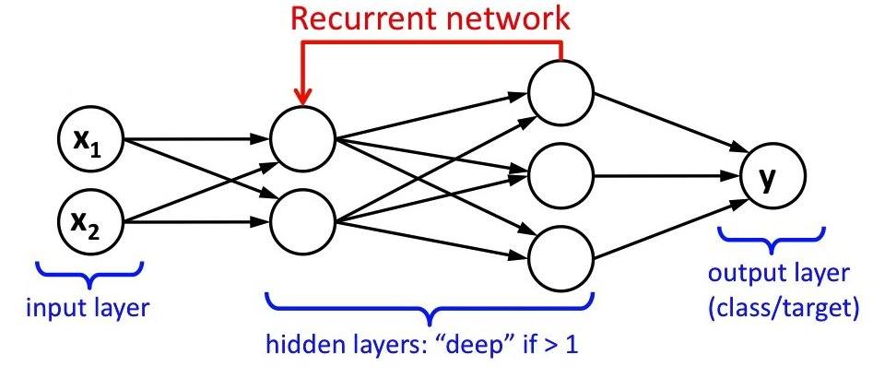

Slide 53
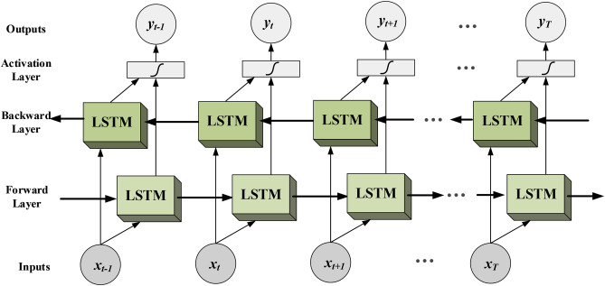

Slide 54
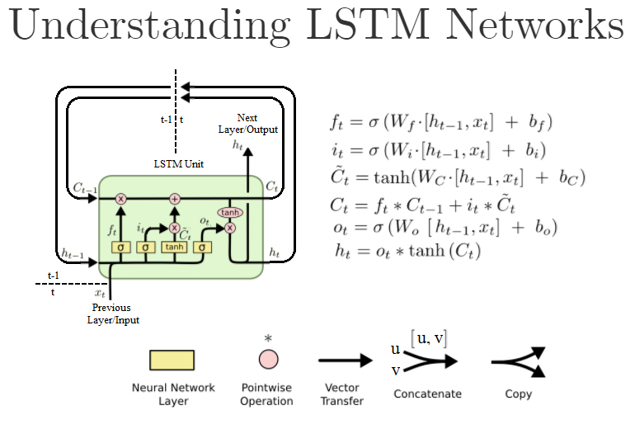

Slide 55
Neural Networks & Artificial Intelligence
In some circles, NNs are thought of as “brute force” AI, because they start with a blank slate and hammer their way through to an accurate model.
They are effective, but to some eyes inefficient in their approach to modeling, which can’t make assumptions about functional dependencies between output and input.
Gradient descent is not recombining every weight with every other to find the best match – its method of pathfinding shrinks the relevant weight space, and therefore the number of updates and required computation, by many orders of magnitude.

